Slide 1
Pushing WMS services to their limits Smart solutions as candidate INSPIRE Good Practices
8th February 2022

Slide 2

Agenda
Introduction 5’
Presentation of good practice proposal “Making spatial data downloadable via WMS services” 30’
Questions from the audience 10’
Presentation of good practice proposal “Building one access point to dispersed data sources” 30’
Questions from the audience 10’

Slide 3
Good practice proposal – Making spatial data downloadable via WMS services
Marcin Grudzień Pushing WMS services to their limits 8th February 2022

Slide 4

Who are we?
The Head Office of Geodesy and Cartography (GUGiK) is Polish National Mapping and Cadastral Authority
The Head of GUGiK is the Surveyor General of Poland (SGoP) who is also the Head of the Polish Geodetic and Cartographic Service
SGoP coordinates INSPIRE implementation in Poland
SGoP is directly responsible for the harmonisation of datasets for 15 INSPIRE themes

Slide 5
Polish Geodetic and Cartographic Service
Cadastral parcels
and buildings
Utilities
Large scale
topographic
databases
Small scale topographic databases
Orthoimagery
DEM and DTM
Territorial units
Geographical names
Surveyor General of Poland
(1)
Voivodship Marshal
(16)
Head of county (380)
Basic
map
Head of commune
(2477)
Medium scale topographic databases
Local development plans
Addresses

Slide 6


Description of the GP
INSPIRE framework defines different types of network services responsible mainly for providing spatial data to the users. The most popular are:
view services that allow the users to display the data and
download services that allow downloading copies of the spatial datasets
In general, out of these two, view services seem to be less complex
from a user perspective
more supporting client applications
fewer compatibility issues
from a data provider perspective
easier to set up
Therefore, it is to be a good practice to make spatial data downloadable via view services as a supplement to standard download services.

Slide 7

Benefits
View WMS services are in general easier to set up and maintain than download services
Users, especially non-experienced ones, in general, are dealing better with view services compared to download services
view services like WMS are much more intuitive and thus easier to operate with
more lightweight
supported by more client applications

Slide 8
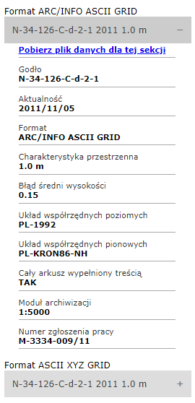
Intendent outcome
Users via WMS services (or, to be more specific, via GetFeatureInfo response) should have access to:
basic metadata describing spatial datasets or their subset
link (URL) to download the dataset or its subset

Slide 9
Evidence of implementation (1)
WMS services published in Poland allows to download:
orthoimagery
based on currency https://mapy.geoportal.gov.pl/wss/service/PZGIK/ORTO/WMS/SkorowidzeWgAktualnosci
based on pixel size https://mapy.geoportal.gov.pl/wss/service/PZGIK/ORTO/WMS/SkorowidzeWgRozdzielczosci
true ortho https://mapy.geoportal.gov.pl/wss/service/PZGIK/ORTO/WMS/SkorowidzePrawdziwejOrtofotomapy
digital elevation model (DEM)
KRON86 elevation system https://mapy.geoportal.gov.pl/wss/service/PZGIK/NMT/WMS/SkorowidzeWUkladzieKRON86
EVRF2007 elevation system https://mapy.geoportal.gov.pl/wss/service/PZGIK/NMT/WMS/SkorowidzeWUkladzieEVRF2007
digital terrain model (DTM)
KRON86 elevation system https://mapy.geoportal.gov.pl/wss/service/PZGIK/NMPT/WMS/SkorowidzeWUkladzieKRON86
EVRF2007 elevation system https://mapy.geoportal.gov.pl/wss/service/PZGIK/NMPT/WMS/SkorowidzeWUkladzieEVRF2007
LIDAR data
KRON86 elevation system https://mapy.geoportal.gov.pl/wss/service/PZGIK/DanePomNMT/WMS/SkorowidzeWUkladzieKRON86
EVRF2007 elevation system https://mapy.geoportal.gov.pl/wss/service/PZGIK/DanePomNMT/WMS/SkorowidzeWUkladzieEVRF2007
land register annual sheet
2021 https://mapy.geoportal.gov.pl/wss/service/PZGIK/EGIB/WMS/KrajoweZestawienieZbiorcze2021
2020 https://mapy.geoportal.gov.pl/wss/service/PZGIK/EGIB/WMS/KrajoweZestawienieZbiorcze
topography
general geographic database (250k) https://integracja.gugik.gov.pl/cgi-bin/BDOO
topographic database (10k) https://integracja.gugik.gov.pl/cgi-bin/PobieranieBDOT10k
3D buildings models https://integracja.gugik.gov.pl/cgi-bin/ModeleBudynkow3D
typhlological maps https://mapy.geoportal.gov.pl/wss/service/PZGIK/mapy/WMS/SkorowidzMapTyflologicznych
geodetic network points
basic https://integracja.gugik.gov.pl/cgi-bin/PodstawowaOsnowaGeodezyjna
archived catalogue https://mapy.geoportal.gov.pl/wss/service/PZGIK/Osnowy/WMS/Archiwalne_kartoteki
photogrammetric data
photogrammetric control points https://mapy.geoportal.gov.pl/wss/service/PZGIK/ZDJ/WMS/Fotopunkty
aerotriangulation https://mapy.geoportal.gov.pl/wss/service/PZGIK/ZDJ/WMS/Aerotriangulacja
mosaic lines https://mapy.geoportal.gov.pl/wss/service/PZGIK/ZDJ/WMS/Aerotriangulacja
intensity images https://mapy.geoportal.gov.pl/wss/service/PZGIK/OI/WMS/SkorowidzeObrazowIntensywnosci
register of geographical names https://mapy.geoportal.gov.pl/wss/service/PZGIK/OI/WMS/SkorowidzeObrazowIntensywnosci
register of administrative units and address https://integracja.gugik.gov.pl/cgi-bin/PanstwowyRejestrGranic

Slide 10
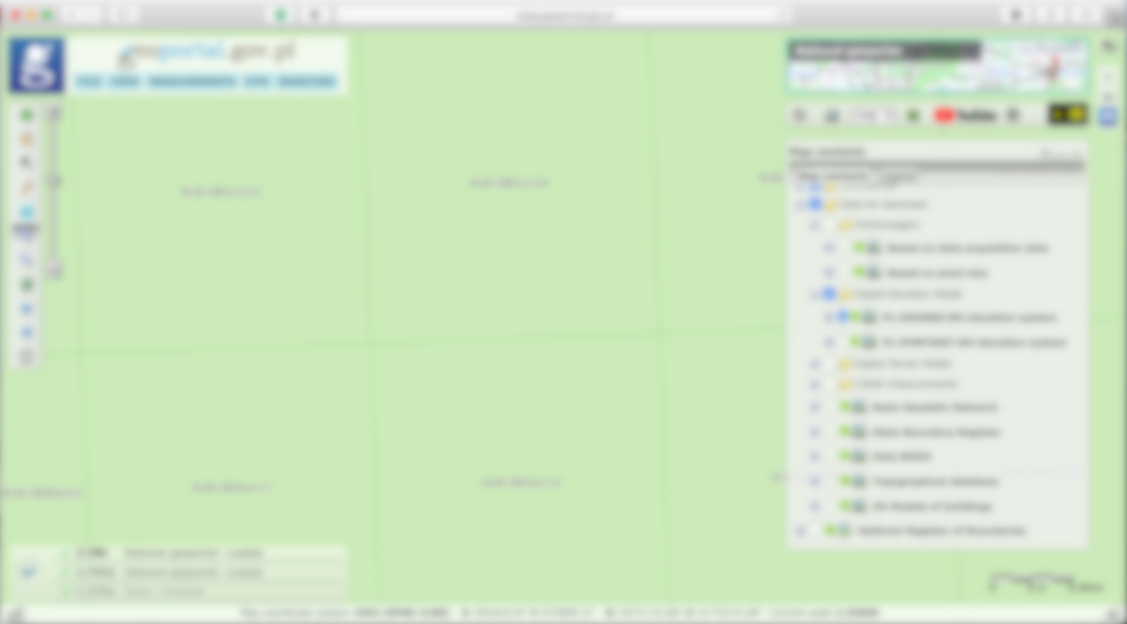
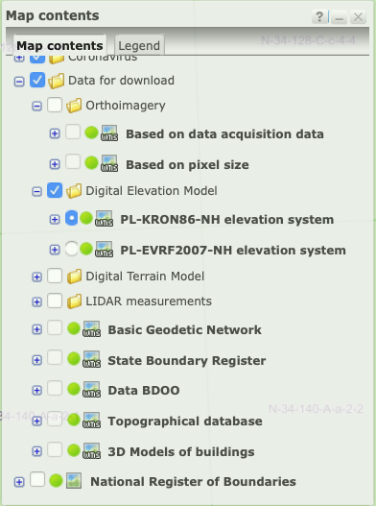
Evidence of implementation (2)
mapy.geoportal.gov.pl

Slide 11
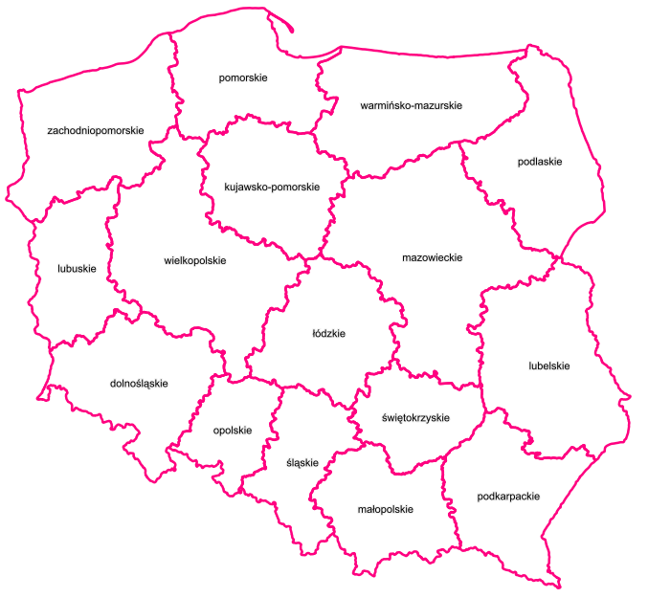
Evidence of implementation (3)
Sources of data:
Majority of published data sets comes from GUGiK e.g. orthoimagery
However there are many exceptions
Topographic Database (10k) is maintained at regional (voivodship) level by 16 Voivodship Marshals
Administrative units are derived based on data supplied by 380 counties
Addresses are captured and maintained at local (gmina) level by 2477 communes

Slide 12















Evidence of implementation (4)
INSPIRE themes covered
Addresses
Administrative units
Coordinate reference systems
Geographical names
Hydrography
Protected sites
Transport networks
Elevation
Orthoimagery
Area management / restriction / regulation zones & reporting units
Land cover
Buildings
Land use
Production and industrial facilities
Utility and governmental services

Slide 13
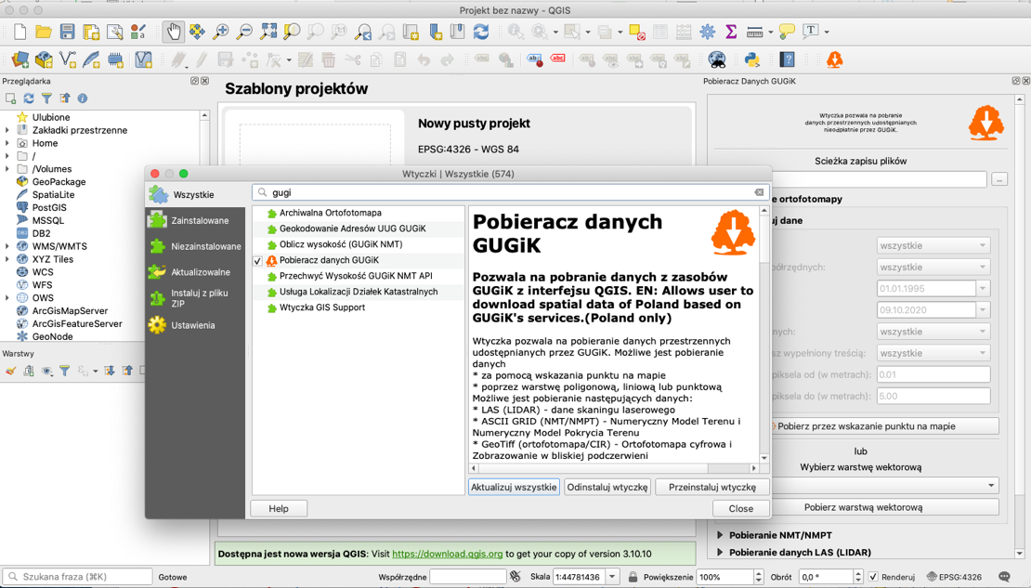
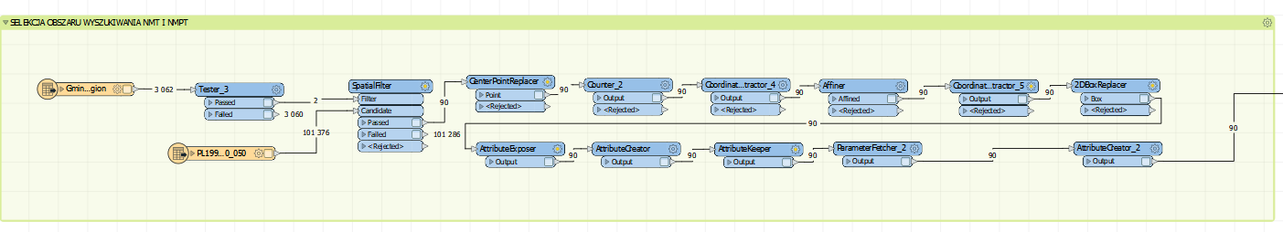
Evidence of implementation (5)
Although the solution was implemented in Poland at the end of July 2020, it seems to be very successful
custom tools available working on top of WMS services to automatise the process of downloading the spatial data.
some of these tools are available for free as QGIS extensions, e.g. pobieracz danych GUGiK or BDOT10k_GML_SHP.
some require proprietary software, e.g. FME.

Slide 14
Evidence of implementation (6)
Users downloaded over the last 17 months over 922 TB of spatial data.

Slide 15

Limitations
WMS download services have to be published and maintained
Subsets of the datasets for download have to be available and regularly updated at network locations accessible from the Internet

Slide 16
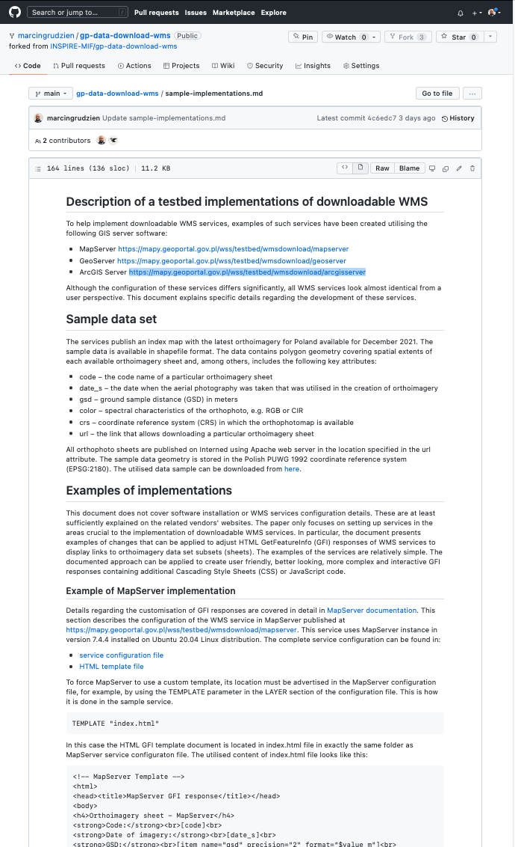
Sample implementations
Our approach
Sample services for three platforms implemented
MapServer v7.6.4 https://mapy.geoportal.gov.pl/wss/testbed/wmsdownload/mapserver
GeoServer v2.20.1 https://mapy.geoportal.gov.pl/wss/testbed/wmsdownload/geoserver
ArcGIS Server v10.8 https://mapy.geoportal.gov.pl/wss/testbed/wmsdownload/arcgis
From a user perspective, all three services are almost identical
WMSs develop using standard vendors documentation except the handling of GetFeatureInfo requests
As simple as possible
Everything documented on GitHub

Slide 17
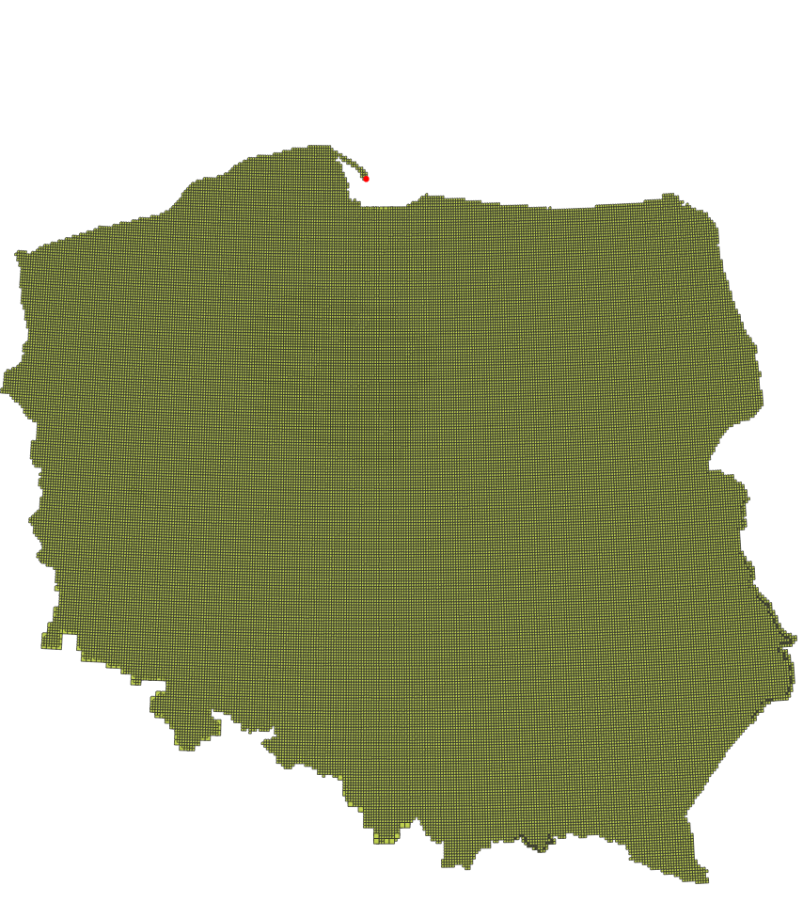
Data sample (1)
Index map with orthoimagery sheets for the area of Poland
Currency – December 2021
Format shapefile
CRS EPSG:2180

Slide 18
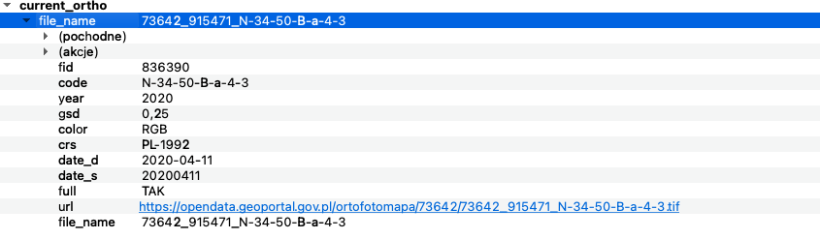
Data sample (2)

Slide 19
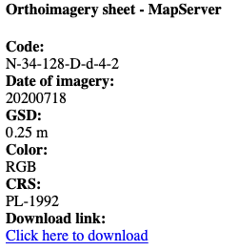
MapServer sample
MapServer utilises templating approach to customise GFI response
In the example, HTML sample template was created
In the template file values of attributes are put in square brackets e.g., <div> Date of imagery: <br>[date_s]</div>

Slide 20
GeoServer sample
GeoServer utilises templating approach
In the example, HTML sample template was created
In the template file values of attributes from GFI are put in curly brackets e.g., <div> Date of imagery<br>${feature.date_s.value}</div>
In some cases editing of header.ftl and footer.ftl files located in gs-wms-<version>.jar library may be required

Slide 21
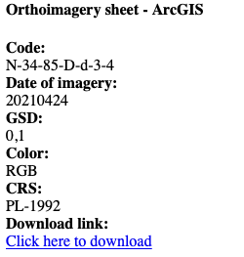
ArcGIS Server sample
ArcGIS Server XSLT transformation to customise GFI response
The GFI response is returned in XHTML
The response can be transformed to the desired structure using the appropriate XSLT file

Slide 22
Summary
Downloadable WMSs are a simple way to share spatial data
Fit especially to non-experienced users
Highly customisable
Supported by at least most popular WMS server solutions
Supported by default by WMS client software
More on https://github.com/INSPIRE-MIF/gp-data-download-wms

Slide 23
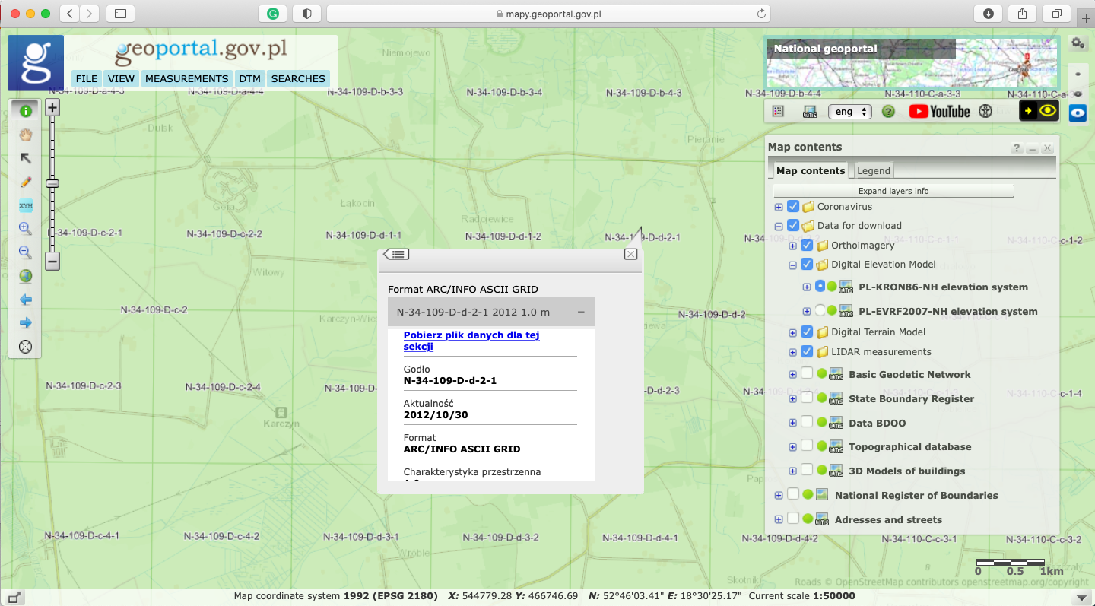
Live demo

Slide 24
Thank you for your attention.
Questions?
marcin.grudzien@gugik.gov.pl

